Slide 1
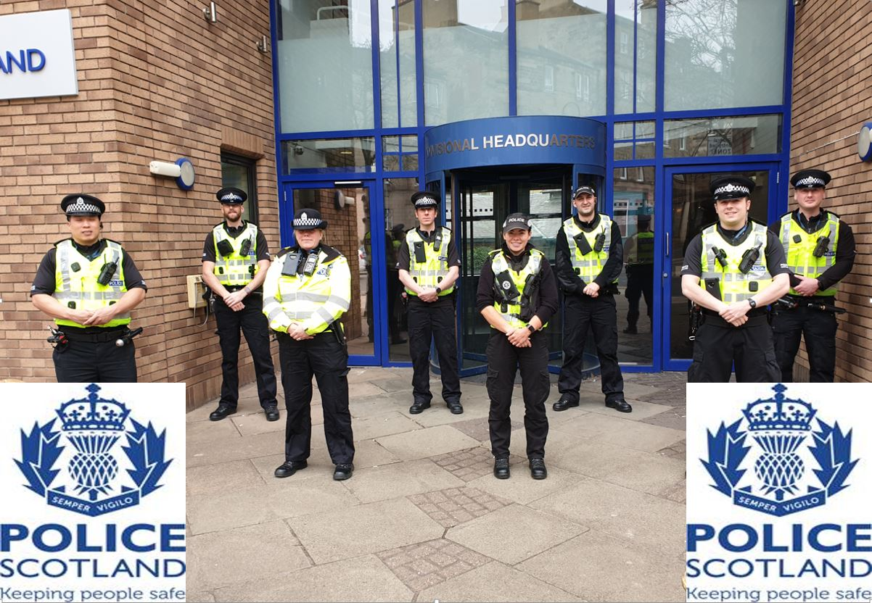
South East Edinburgh Community Policing Team Newsletter
Issue 2 – June 2022

Slide 2
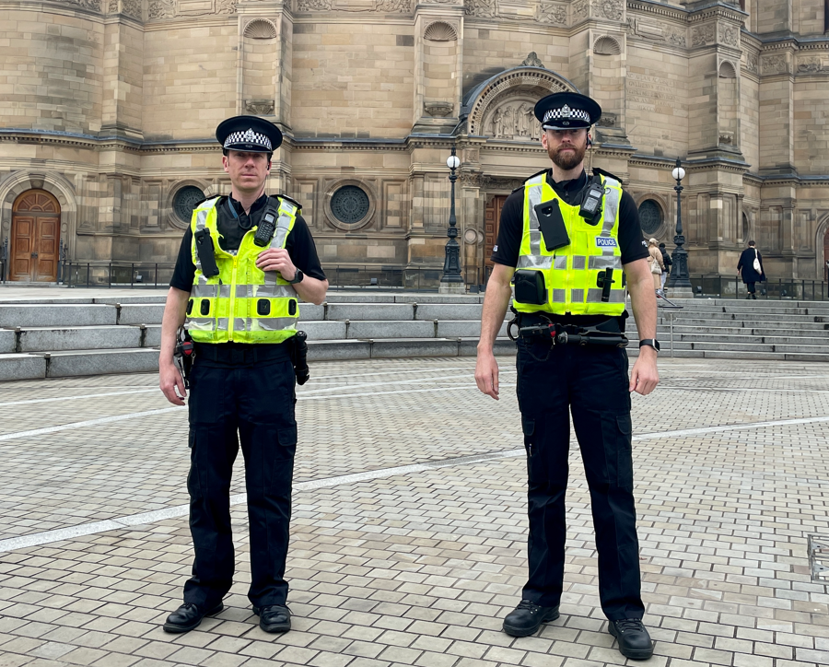
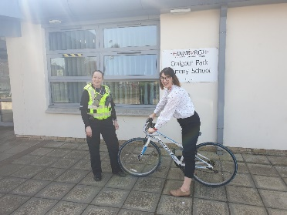
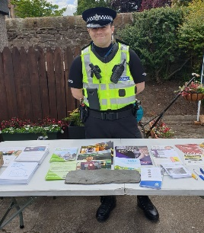
SE Edinburgh CPT - Quarterly Bulletin
Meet the Sergeants
Shut out scammers
Bikes to school / refugees
Barry Mercer and Grant Robertson are the Community Sergeants for Edinburgh South East. Both have been in their community posts for around 3 years having transferred from front line response policing. They have a wealth of policing
Over the last few months we have been raising awareness of the latest “Shut Out Scammers” campaign, targeting bogus workman and rogue traders. With the increase in the cost of living criminals often adapt their methods to take advantage of members of the public. Current scams include mis-selling energy efficiency measures, door to door sales and cold callers offering to carry out garden or maintenance work.
We have held events and had stalls at a number of locations across the area including bowling clubs, open days, in local shops and in the street. We want you to feel empowered to question cold-callers, turn away anyone whose identity you do not feel is genuine and say “No thanks”.
If you receive any text messages or emails purporting to be from official agencies check the spelling, how you have been addressed and the email address / phone number it has been sent from. If you are suspicious delete the email / text and contact the relevant agency / company yourself using their official contact details.
In June, a 34 year male was arrested and charged after being found in a private garden after offering to carry out work. Please tell us if you think a bogus caller has called on you, or been in your street, report this immediately on 101 or in the case of an emergency, dial 999.
The team were delighted to receive an award from the Local Partnership & Initiative Fund. With the money we were able to purchase ten pedal cycles from the Bike Station which we donated to local schools. These bikes will be used by a range of pupils across the area and will help to promote safe cycling as well as a healthy and active lifestyle.
We received new pedal cycles for our officers . Through our local partners we were able to recycle them with Bikes 4 Refugees, a charity with an Edinburgh office that supply refurbished bike for Refugees living in the city. The bikes will be used to navigate the city and were greatly appreciated by the staff at charity. It was great to see our bikes continuing to be used in this way.
experience which they use to serve and support communities.
Barry and Grant have a strong team of officers and have a wide network of partners. Barry covers the Southside, Morningside and Meadows and Grant has responsibility for the Liberton Gilmerton area.
Grant believes “safeguarding communities cannot be done in isolation and we embrace partnership working with 3rd party, public sector, private businesses and local residents. Without information from the public we would not be able to serve our communities and deal with the issues that matter to you”.
Community police is built on the relationship between the police and it residents, Barry said “both myself and my team are committed to improving community wellbeing through education, engagement, partnership working and enforcement, when necessary. Your help is essential to addressing the issues that are important so please report any matters that give you cause for concern”
.
South Initiative Team
The South Initiative Team (SIT) have been very busy over the last three months seizing £44,500 worth of drugs and £10, 000 in cash, which is linked to the proceeds of crime. We have also arrested two prolific housebreaker in the area and seized three motor vehicles, that had no insurance.
Information from the community is key in helping us tackle these problems and can be reported through 101 or Crimestoppers 0800 555 111.

Slide 3
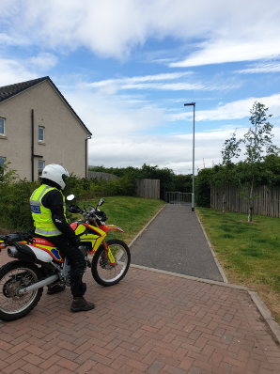
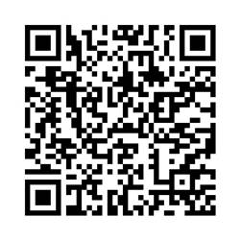
SE Edinburgh CPT - News + Updates
Off road motorbikes
Thefts and prevention measures
We are aware of community concerns in relation to off road motor bikes within the area. This is not localised to the south east of Edinburgh.
We have requested additional support
from our road policing colleagues in an
effort to tackle this issue, including
deployment of our off road motor bike
section. We believe the riders are mostly young people and we are liaising with partner agencies, including local schools.
In recent months there has been an increase in the number of motorbikes being stolen throughout the city. This is believed to be linked to the influx of tourists using motorbikes to tour Scotland. We have identified this as an area of concern and all reports are being robustly investigated.
We have visited a number of holiday accommodation premises and provided crime prevention advice and where necessary made recommended improvements to the site. A number of leaflet have also been delivered which will be used to inform visitors on steps they can take to protect their property.
Theft of pedal bicycle remains a priority for us. We fully acknowledge the impact this has on our communities, in particular due to the increase in financial pressure placed on people/families.
We are regularly patrolling hot spot areas to increase visibility and deter criminals. Working alongside Cameron Toll we were able to purchase 100 bike marking kits using their community engagement fund. To date we have marked 43 bikes. To find out when the next event is please follow our twitter account, the details are on the last page.
PC Mckendrick has been working in partnership with local bike shops providing all new bike owners with crime prevention advice. Due to the high value of some bikes they can be an attractive target for thieves. It is important that your bicycle is secured whenever it is left unattended, even if this is for a matter of seconds. When securing your bicycle it is important to consider what type of lock you are using, the position of the lock and what you are securing your bicycle to. We also recover a vast amount of bicycles and accurate information can assist us returning stolen bicycles to their owners. Please keep a photograph of your bike including serial numbers or any identifying features in the unfortunate event that it is stolen.
Please scan this QR Code and you will be taken to the Police Scotland crime prevention web page
where you will find some helpful advice to consider when securing your bicycle.
To date one young person has been identified and will be charged with numerous road traffic offences. We review all reports and where possible will maximise CCTV opportunities in an effort to identify offenders.
We have recently purchased DNA tagging spray and will be increasing the number of trained officers during the month of July.
If you know of someone in your street that has either a petrol or battery powered off road motor bike and they are using it in a public space, please let us know. We need your help to stop this dangerous behaviour.

Slide 4
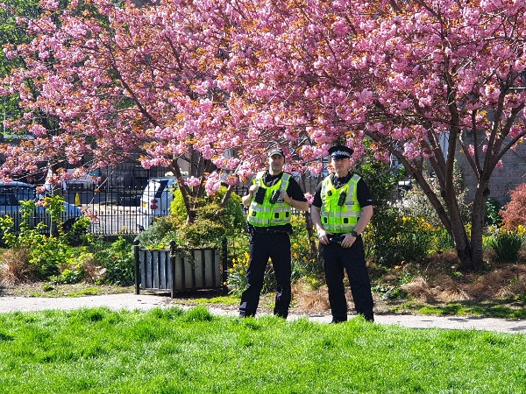
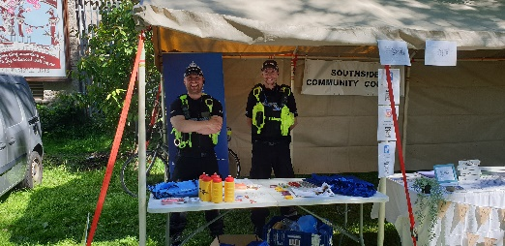
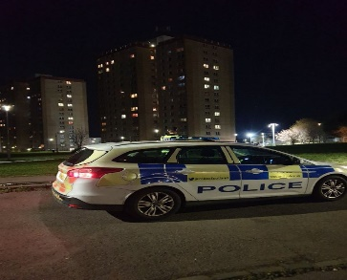
Antisocial behaviour – Young People and Street Drinking
Recent weeks have seen groups of young people attending the Gilmerton area. The intention has been to cause disorder. This is unacceptable behaviour and will not be tolerated. To date we have charged 4 young people with violence and ASB related offences. If we receive any information about a potential altercation, we are quick to act to prevent disorder within the community. Any information you have about planned altercations or tensions is vital to helping us keep our communities safe. Any young person we identify as being present during a fight will be visited by the community team so the matter can be highlighted with their parent.
School inputs continue to given by out School Link Officers and highlight a variety of topics including appropriate behaviour, internet safety and alcohol awareness. We are also planning to run a ‘No Knives, Better Lives’ campaign after the summer holidays.
On identifying any young person of particular concern we are referring them to the Stronger Edinburgh group. This is a multiagency group which includes police, social work and Family Housing and Support. We ensure relevant information is shared in an effort to support/encourage the young people to choose positive destinations.
Officers are routinely attending at youth engagement events in an effort to encourage responsible behaviour. We look forward to supporting the community outreach work planned out by Life Long Learning & Development over the next couple of months.
We have also been dealing with an increase in calls relating to ASB and drinking alcohol to the Nicolson Square area. Local officers regularly patrol this area to deal with any criminality and deter those who gather and cause issues for residents and businesses. We are working with partner agencies, including local charities and the Family and Housing Support Department in respect of this issue. Recently a 40 year old female was arrested for offences committed in Nicolson Square and we will continue to carry out high visibility and plain clothes patrols in the area.
If you witness any criminality or ASB regarding any of the issues above then please tell us about it by reported through 101 or Crimestoppers 0800 555 111. Your information is vital tacking these issues
Community Events
It was fantastic to get out and about at some of the recent community events. We had Community Officers at the Meadows Festival and Sciennes Summer Fair in the last few weeks. There were several thousand people at the Meadows Festival and PCs Flynn and Kelly remarked on how good natured the event was and how many people were happy to see them and have a chat.
It has been great to engage with so many members of the community and we appreciated being invited to these events. If you have any upcoming community events that we can assist with or you would like us to attend, please contact us via the details at the end of this newsletter and we will accommodate when possible.
Looking ahead
As we look to the months ahead we will commence planning with partners for the summer holidays and hopefully nicer weather . This change in season also means that windows and doors can be left open as we spend more time in the garden. Please make sure your property is safe and secure and we will have uniformed and plain clothes officers out and about day and night.
We also want you to enjoy the greenspaces throughout the summer months so will have officers patrolling these areas to minimise any anti social behaviour.

Slide 5
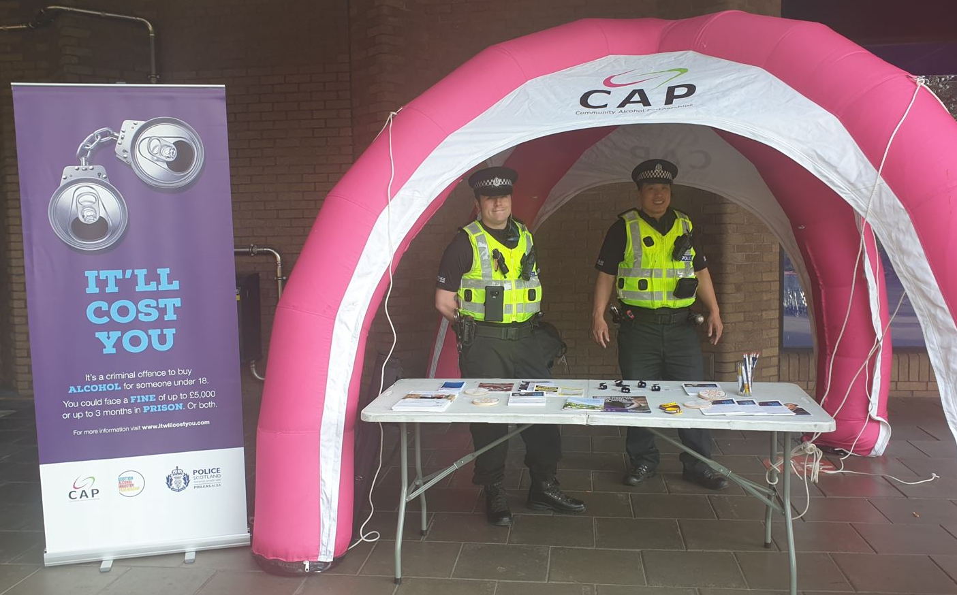
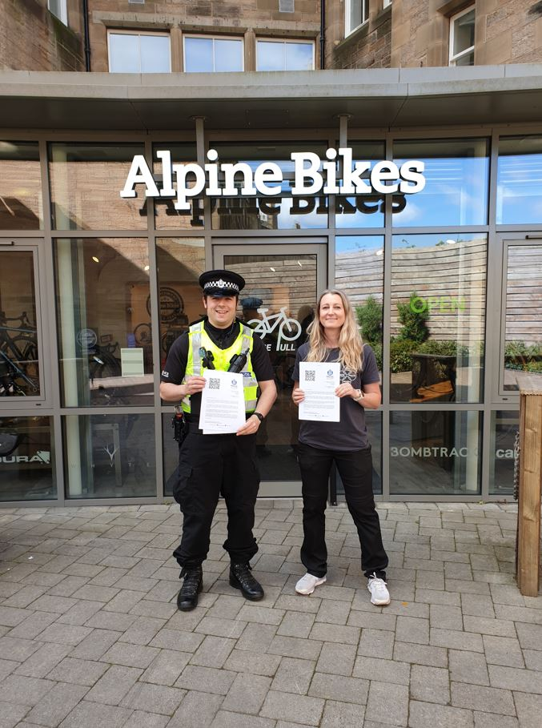
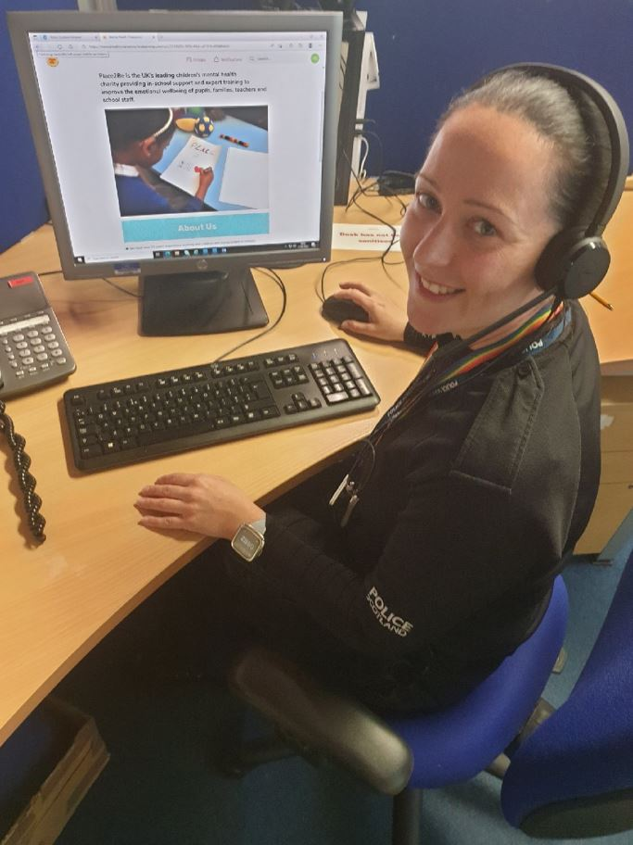
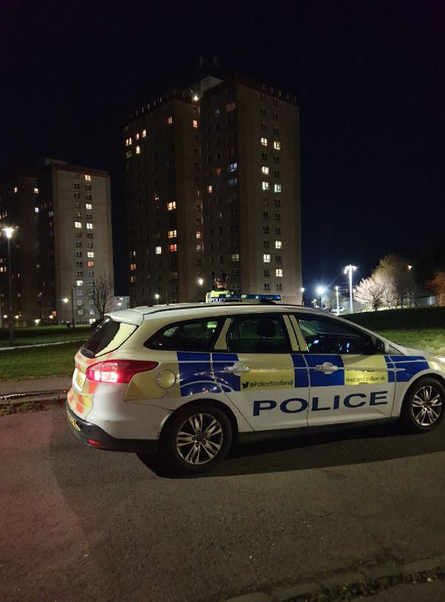
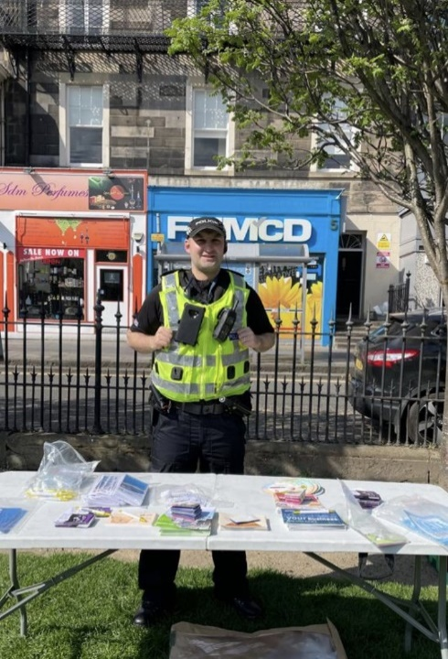
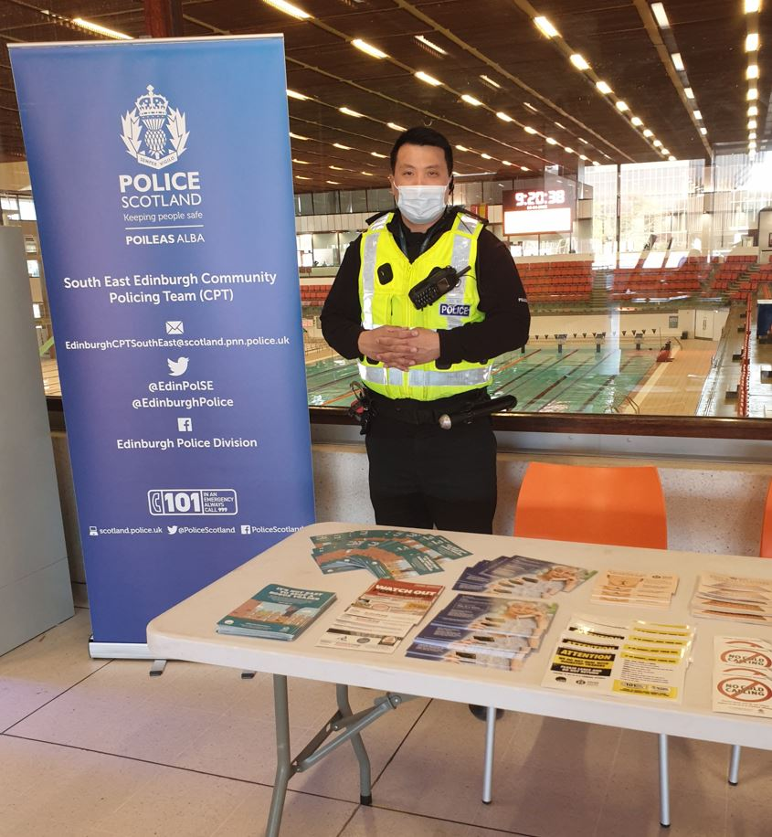
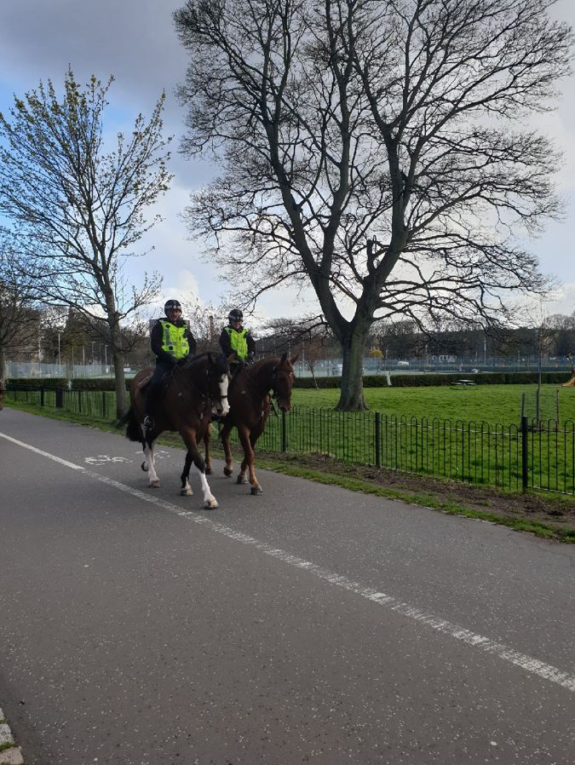
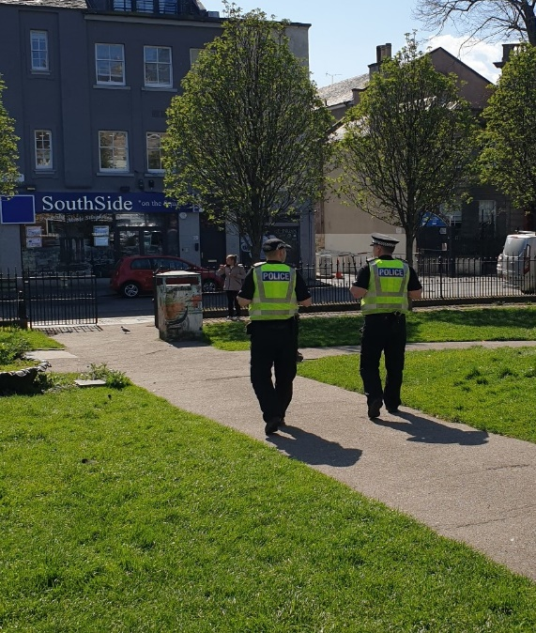
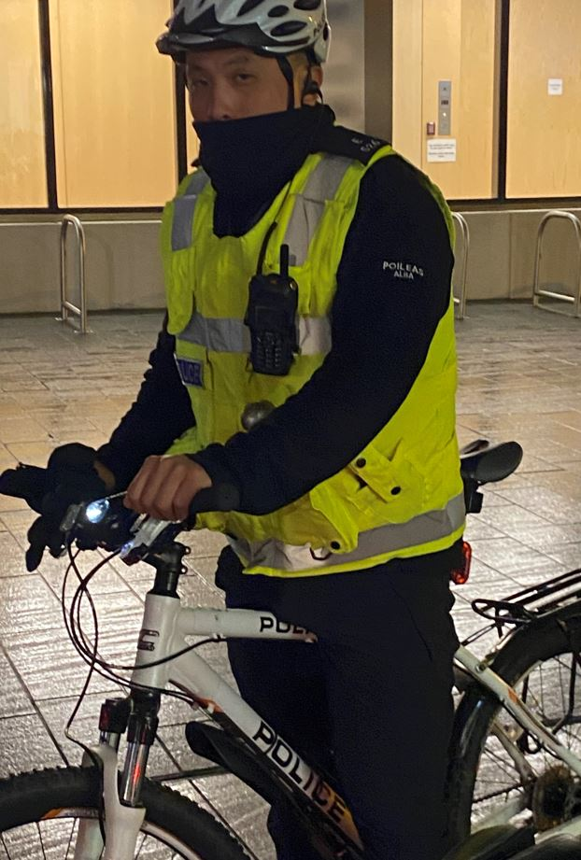
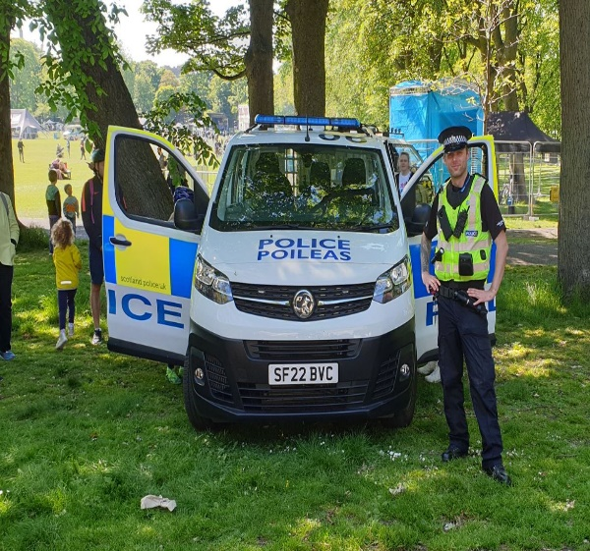
Your local officers in the community

Slide 6


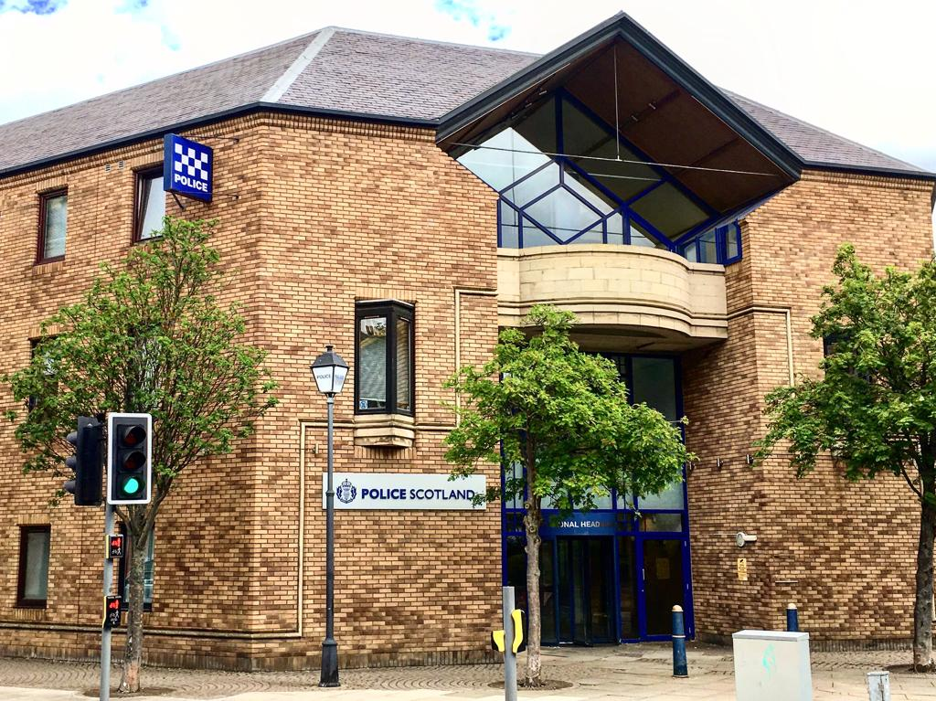




About Us
Local Area Commander:
Chief Inspector Murray Tait
SE Edinburgh Community Policing Team:
Inspector Carlyn Simpson
Sergeant Barry Mercer
Sergeant Grant Robertson
7 Community Officers dedicated to community issues in the Southside/Newington, Meadows/ Morningside wards of South East Edinburgh
2 School Link Officers
2 Local Partnership Officers
A proactive, plain-clothes South Initiative Team.
Contact Us:
101 for non emergencies
EdinburghCPTSouthEast@Scotland.pnn.police.uk
@EdinPolSE
Edinburgh Police Division
www.scotland.police.uk

