Slide 1
South East Edinburgh Community Policing Team Newsletter
Issue 1 – March 2022

Slide 2
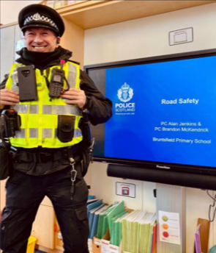
SE Edinburgh CPT - Quarterly Bulletin
Welcome
Hello and welcome to the first South East CPT newsletter of the year. We hope you are all well and 2022 is a year we can all remember for the right reasons. This is our first newsletter and we aim to provide you with a flavour of work undertaken by your local community policing team over the last quarter and what we will be focusing on in the coming months.
Recent Issues
Pedal cycle thefts are occurring in the Southside area. Please ensure that bikes are well secured using a good lock / chain / ground anchor, register it on the National Cycle Database and never leave your bike unattended and insecure even for a short time. Further advice is on the Police Scotland webpage.
We are still dealing with reports of ASB and alcohol consumption in the Astley Ainsley Hospital grounds. Patrols are continuing in the hospital and surrounding areas including the Meadows and Warrender Park. Officers will engage with any persons suspected of being involved in ASB and any reports of criminality will be investigated. Please report any incidents to the police to allow us to focus our patrols in the relevant areas.
Community Officers from the South East are continuing to support colleagues in the City Centre with demonstrations taking place in relation to the current situation in Ukraine. This has had a profound effect on many people both within Edinburgh and across the world and we will continue to provide an appropriate response to allow all related protests to take place peacefully.
Crime prevention
Door Step Crime
The approach of springtime with lighter and longer days tends to coincide with a rise in doorstep crime and bogus workmen incidents. Criminals attempt to pose as genuine employees of utility companies, construction workers and even police officers.
Our advice to help prevent yourself falling victim to any of these type of scams is to be wary of anyone calling at your home unexpectedly and then asking for access to the property.
If this does occur, ask for identification and do all you can to verify it with the organisation they claim to be representing.
Please also remember, that there is no need to be embarrassed to tell any cold-caller ‘no thank you’ and cease your engagement and interaction with them. If you think a rogue trader or bogus caller has called on you, or been in your street, report this to the police immediately on 101 or in the case of an emergency, dial 999. You can find a lot of useful information on stopping scammers on our website at www.Scotland.Police.uk
Looking Ahead
As we move through 2022 we look forward to working with as many of our partners, local residents and businesses as possible. We will continue to tackle road safety issues across the area, work to reduce incidents of ASB using a range of tactics including education, diversion and enforcement.
With the upcoming spring and summer months and hope to see an improvement in the weather and our focus will be patrolling public spaces including the Meadows to tackle incidents of ASB.
Community and specialist officers will also be focussing on serious and organised crime, drugs and crimes of dishonesty under the banner Operation Vanguard.
If there are any issues you wish to bring to our attention then please contact the SE Community Policing Team via the details at the end of this newsletter. Alternatively you can report issues anonymously on 0800 555 111 or online at the CrimeStopper website.
Please follow our Twitter page for regular updates and photographs of our work –
@EdinPolSE
PC’s Jenkins and Mckendrick visited Bruntsfield Primary School to discuss road safety with pupils and to help the schools Junior Road Safety officers. Further visits are planned to all primary schools in the area in the coming months as part of Operation Slowtime.

Slide 3
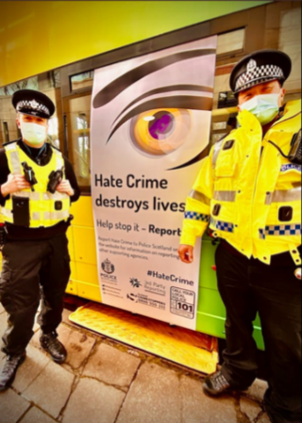
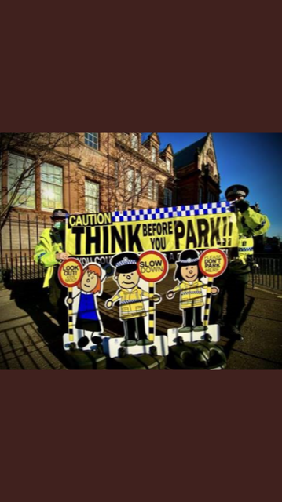
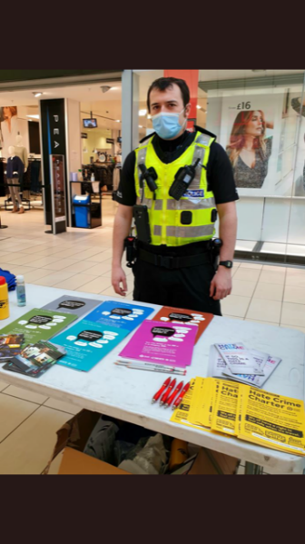
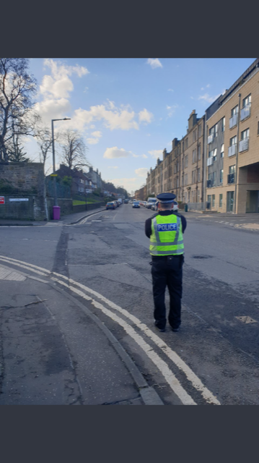
SE Edinburgh CPT - News + Events
Hate Crime Awareness Week
Operation Slowtime
During February officers from the South East community policing team hosted a series of multi-agency events and activities with the aim of raising awareness of behaviour that constitutes a Hate Crime, including reporting mechanisms and appropriate ways to challenge.
Sergeant Grant Robertson said “A hate crime happens when a person targets another person because of their sexual orientation, transgender identity, race, religion or disability.
If you are targeted or see someone being targeted, please report it to Police Scotland. When you report, we will do everything we can to support you and prevent the person responsible from causing further harm.
During the first quarter of 2022, officers have been focusing on road safety and road traffic offences.
Officers have been engaging with all local Primary Schools to promote the school streets initiative, ensuring compliance by drivers during the restricted periods and promoting appropriate parking. We have been ably assisted by the “parking buddy” signs and banners that have been acquired through a recent grant.
These will be distributed around all primary schools in the south and east to promote safer parking around our schools.
Hate crimes can happen in lots of different ways, this includes verbal abuse, including online, and threats to harm or being physically attacked. All of which are completely unacceptable and should be reported to us.
There are many different ways you can report a Hate Crime, this includes phoning Police Scotland on 101, or in an emergency always dial 999. British sign language users can contact us through ContactScotland BSL, or the national text relay service. Further details can be found on the Police Scotland website. If you want to report anonymously this can be done through the charity CrimeStoppers by phoning 0800 555 111 or via their website.”
We continue to respond to community concerns relating to speeding in the area and have been utilising the speed gun in a targeted approach to monitor problematic streets.
During the first quarter, officers have charged drivers with a number of road traffic offences including no insurance, no licence, no MOT and speeding offences. Several cars have also been seized for driving with no insurance.
We will continue to adopt a proactive approach to road traffic offences in the area. You can keep up to date with the locations and activity completed by the community team under #OpSlowTime

Slide 4
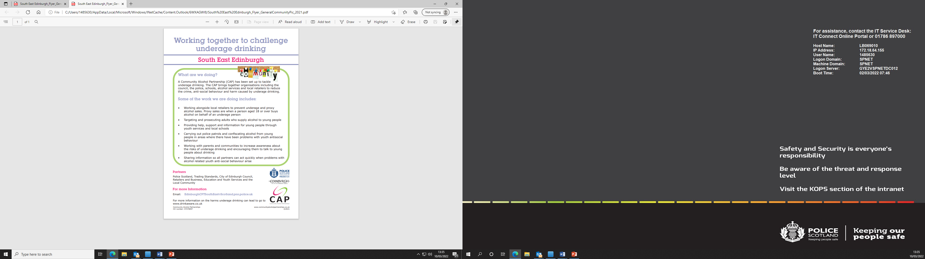
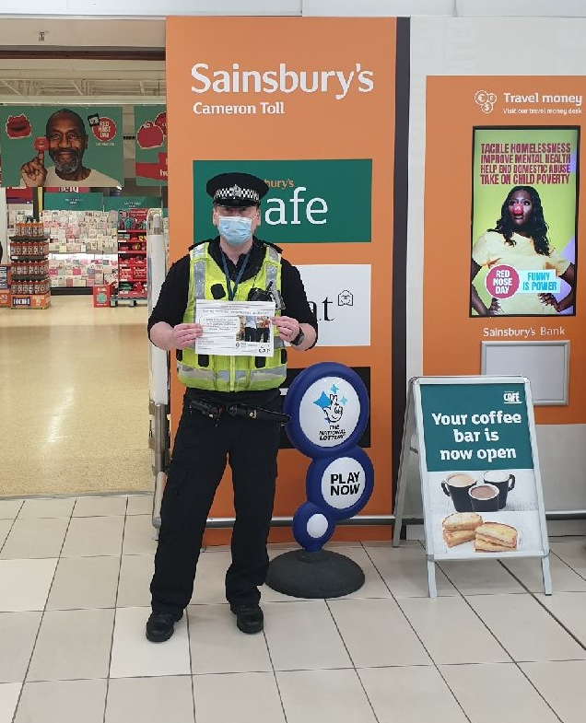

SE Edinburgh CPT - Focus on…
Community Alcohol Partnership
Officers in the South and East have been busy creating a Community Alcohol Partnership (CAP) for the area. The aim of the CAP is for the Police to work in partnership with other organisations to develop a culture where both adults and young people drink responsibly. We wish to ensure that young people under the age of 25 are educated on safe consumption limits, personal responsibility and the effects of alcohol on them and others.
The CAP has five main objectives:
1. Reduce youth ASB associated with alcohol consumption
2. Improve the alcohol education offer for young people
3. Enhance diversionary activities for young people
4. Reduce incidents of street drinking and support street drinkers into appropriate treatment
5. Develop a responsible retailing ethos and effective partnership approach in the CAP area which embraces Challenge 25 and acceptance of Proof of Age Standards Scheme
Officers have been out in the community working in partnership with local retailers, engaging with young people within educational settings and promoting diversionary activities through the “Kickstart” initiative within schools.
Sgt Barry Mercer “The partnership approach recognises that enforcement can only partly achieve the vision and that in order to shift a culture there is a need for all the organisations and agencies to work together, alongside the local community. By working together, far more can be achieved than working in isolation”.

Slide 5


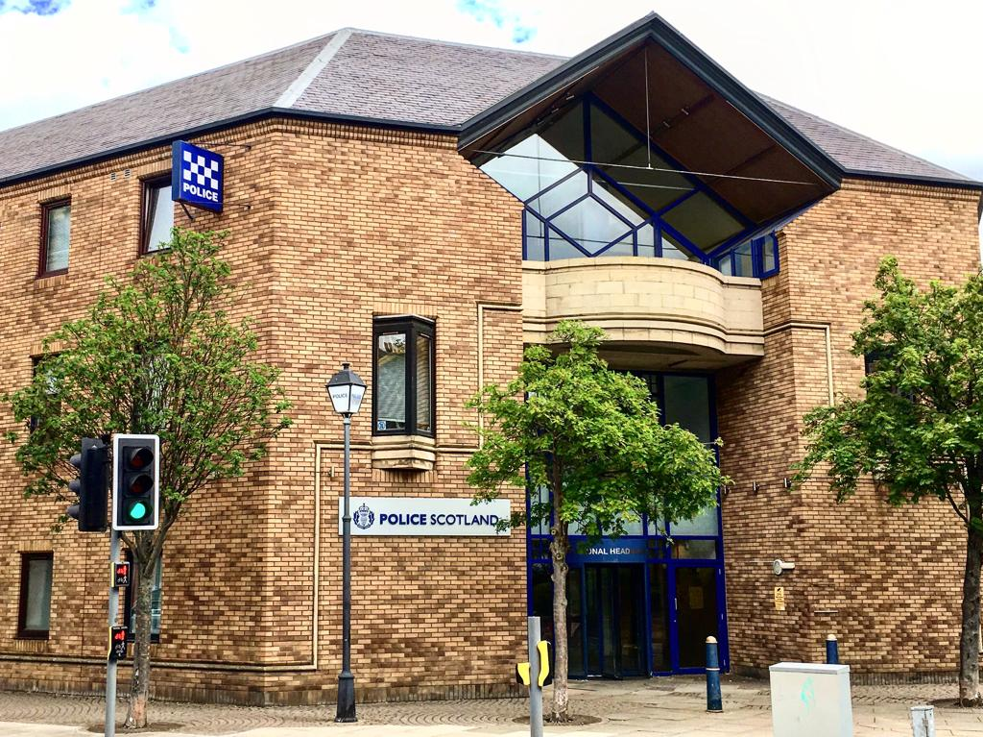




About Us
Local Area Commander:
Chief Inspector Murray Tait
SE Edinburgh Community Policing Team:
Inspector Carlyn Simpson
Sergeant Barry Mercer
Sergeant Grant Robertson
7 Community Officers dedicated to community issues in the Southside/Newington, Meadows/ Morningside wards of South East Edinburgh
2 School Link Officers
2 Local Partnership Officers
A proactive, plain-clothes Locality Initiative Team.
Contact Us:
101 for non emergencies
EdinburghCPTSouthEast@Scotland.pnn.police.uk
@EdinPolSE
Edinburgh Police Division
www.scotland.police.uk

